Slide 1

2019 Employee Data Report
Phillip Hale
For additional details on the dataset and findings refer https://github.com/naivelogic/MSDS/tree/master/CaseStudy2
Notes:
Welcome to the 2019 Employee Data Report. My name is Phillip Hale and I want to take this moment to thank the CEO and CFO from Frdolay for allowing us the opportunity to collaborate with your teams to share our insights and predictive models to help you, your management team and your employees achieve more.
Also note the link in the left hand corner of the slide take you to the gihub repo that provide your engineers and anlayis full access to reproduce the results, detail model analysis and other supporting information used in this report

Slide 2


Overview
Top factors for employee attrition
Insights from predicting employee attrition
and potential correction indicators
Insights on employee salaries
and the corresponding impacts
Notes:
Today we are going to be discussing a couple of key insights that we have uncovered from the 2019 Employee Data Report. We are going to cover three key items that was top of mind for your management team. We will be discussing insights on
Top factors for employee attrition
Insights from our prediction model on predicting employee attrition and potential correction indicators
Top Factors and insights on employee salaries and the correspongin impacts that your team can take advantage of
EMS Overview
© 2014 Microsoft Corporation. All rights reserved. Microsoft, Windows, Surface and other product names are or may be registered trademarks and/or trademarks in the U.S. and/or other countries. The information herein is for informational purposes only and represents the current view of Microsoft Corporation as of the date of this presentation. Because Microsoft must respond to changing market conditions, it should not be interpreted to be a commitment on the part of Microsoft, and Microsoft cannot guarantee the accuracy of any information provided after the date of this presentation. MICROSOFT MAKES NO WARRANTIES, EXPRESS, IMPLIED OR STATUTORY, AS TO THE INFORMATION IN THIS PRESENTATION.
8/18/2019
2

Slide 3


d
Data Set
Reviewed over
870
Employees
across
9
Job Role Types
in
3
Departments
Notes:
Just a quick highlight on the data used behind this report. We reviewed over 870 different employes, across 9 different job role types in 3 differnt departments. There were no missing data, but we did perform several data transformation, primarily performing log transformatons to monthly income
With that said, lets get to the insights, first starting with employee attrition

Slide 4


MONTHLY INCOME BEST CORRELATED ATTRITION INDICATOR...
Top 5 employee attrition correlated indicators
Notes:
To gain an understanding of the variables that would indicate whether an employee would leave or stay we correlated all the variables together with employee attrition and the correlation test found that Monthly Income had the highest correlation indicating a high relationship with attrition. The correlation resulting in a negative -0.2, while this indicator overall is on the low end, this indicates everytime monthly income increase, attrition is decreases. This insight is not ontly valuable for attrition prediction but also for when we predict salaries.
Next we look at indicators for the logistic regression model

Slide 5
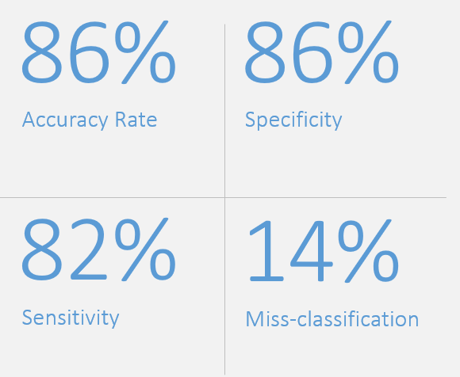
Employee Attribution Model
Results from employee attribution
prediction model
Notes:
When reviewing the key performance indicators we assess the accuracy rate, specificity, sensitivity and the rate of misclassification.
* Overall - The prediction model that we used based off the data, we obtained an accuracy rate of 86% when the model was introduced to new data, which is quite good.
When the model was tested on new data,
the Sensitivity rate of 82% indicating 82% of employess identified to not turnover were correctly predicted to not turnover
Also obtained a Specificity rate is 86% indicating when model was tested for those that turnover, the result was 86% were correctly predicted
Missclassification rate of 14% - we want to keep this as low as possible
While there is tradeoff that we are happy to discussion, working with your team we concluded that We can compromise on sensitivity here insteas of specificity.
#If we wrongly reject a good employee, our loss is very less compared to indicating turnover to an employee in good standings.
Additionally, we found
When holding all other variables fixed, the odds of getting attrition for Overtime workers vs the odds of employee attrition for non-OT worksers is exp(1.88546) = 6.59. In other words, the odds for OT workers are 6 time higher than odds for non OT worksers, in the fitted model when holding all other variables fixed.

Slide 6
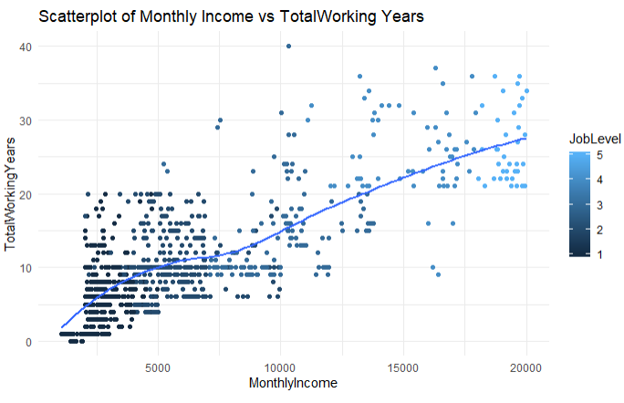
Notes:
First we look at the scatterplot of monthly income and total working years that we assessed for each employee. We can see that as income increased, so does Total working years. Attitionally, as the dots on the scatter plot go from dark to light, that indicates the increase in job level which also is positivlty correlated with both Total Working Years and Monthly Income. Therefore, these appear to be excellent indicators for predicting Monthly Income.
One interesting item to note was the Gender was not a significant predictor in this dataset. Therefore, Sex of the employee is not associated Monhtly Income (correlation score of -0.07)

Slide 7

Results from Linear Regression Model
90%
$1,312
R-Squared
Root Mean Squared-Error
-1877
Predictor Variables:
Job Level
Job Role
Attrition
Total Working Yrs (Log)
Akaike information criterion (AIC)
Notes:
Here are some of the highlights used to assess the model performance,
R-squared is approximately 90% indicating 90% of the variation in salary can be explained by the model.
RMSE value of $1.312 which is a measure of distance in how far the prediction errors wer to the actuals
This model also utilized the lowest AIC socre of -1877 indicating the best model selected.
The variables used in the model was – Job Level , Job role , Attrition and the total working year on the log scale
More details
All linear regression assumptinos were met for normality, independence and equal variance
One item of interest was effect Job Level had on salary. When adjusting for all other model variables, we associated a one-unit increase in JobLevel having an effect of appropimatly 43% increase in the geomatri mean of Monthly Income. This mean Job Level plays a key role in Salary amount.
Overall significant test from the F-statistic (497) with p-value <0.001 showing overall signficancec of the model.
Slope for is the effect of JobLevel is 0.35 indicating the effect job level has on salary adjusting for the other varaibales, we associate a one-unit increase in JobLevel, we can expect to see about a 43% increase in the geometric mean of Monthly Income, since exp(0.3538) = 1.430
More details on the linear regression model can be found in the gihub-page

Slide 8

Recap: 2019 Employee Report
Employee Attrition - key indicators for employee turnover were employees working overtime, lower Salary and a decrease in job involvement.
Monthly Income Prediction – JJob Role and Job Level were key to predicting salary
Age and Gender - with continued practice, Age and Gender were indicated to not be key factors in predicting Salary and Turnover.
2019 Employee Report – For more information please refer to https://github.com/naivelogic/MSDS/tree/master/CaseStudy2
Notes:
As a recap – – key measurable indicators that we found were
Employee attrition– whre employees that were most likely to turnover are those that (1) most importantly workovertime and (2) have lower salaries. Also, we saw decreased in job involvement and increased time_till_promotion.
In terms of monthly income – Job Role and Job Level were key to predicting salary
Age and Gender – Good news! Yall are on the right track with employee management as both Age and Gender were not significant factors or indicators used in the models. We would indicate that there is a slight tendacy for those younger in age to be more likely to leave. This was appartent in the Employee attrition model werhe maritial status = single, but Age itself was not a key factor. Contrary to other industries, the dataset provided indicated no significant indication gender was a key factor in turnover or a wage gap.
Thank you all for your time. in the attached documents you can find my contact information.
Also note the link in the left hand corner of the slide take you to the gihub repo that provide your engineers and anlayis full access to reproduce the results, detail model analysis and other supporting information used in this report

Slide 9
OVERTIME WORKERS MOST
IMPORTANT ATTRITION INDICATOR...
Top 5 employee attrition indicators in the United States
Notes:
For the classification problem we seek to predict employee attrition, the final model selected was the logistic regression model. In the next slide we will go over the prediction results and performance.
On this slide it is noteworthy that we indicate the key relationship between the variables in the model and their relative importance in predicting attrition. The graphic shows that (using the absoluate value of the t-statist for each model parameter), we are able to see that employees working Overtime when accounting for the othe variables in the modlel is the highest importance indicator, for attrition,. This is then followed by Singile individuals and then Monthly Income. Recall in the last slide, Monthly Income was the highest single correlated value, it was later discovered using stepwise selection for selecting predictor variabeles that Overtime = Yes would play the hight relative importance to predicting attrition in the model.
Lets get to some additional insights on model performance!!

